Slide 1
Introduction to Containers
Lecturer: Ngo Huy Bien
Software Engineering Department
Faculty of Information Technology
VNUHCM - University of Science
Ho Chi Minh City, Vietnam
nhbien@fit.hcmus.edu.vn

Slide 2

Objectives
To explain how containers work.

Slide 3

Contents
Containers.
Linux Namespaces.
Linux Control Groups.
Linux Root Filesystem.

Slide 4

References
Elton Stoneman (2020). Learn Docker in a Month of Lunches. Manning Publications.
Nanik Tolaram (2023). Software Development with Go. Cloud-Native Programming using Golang with Linux and Docker. Apress.

Slide 5
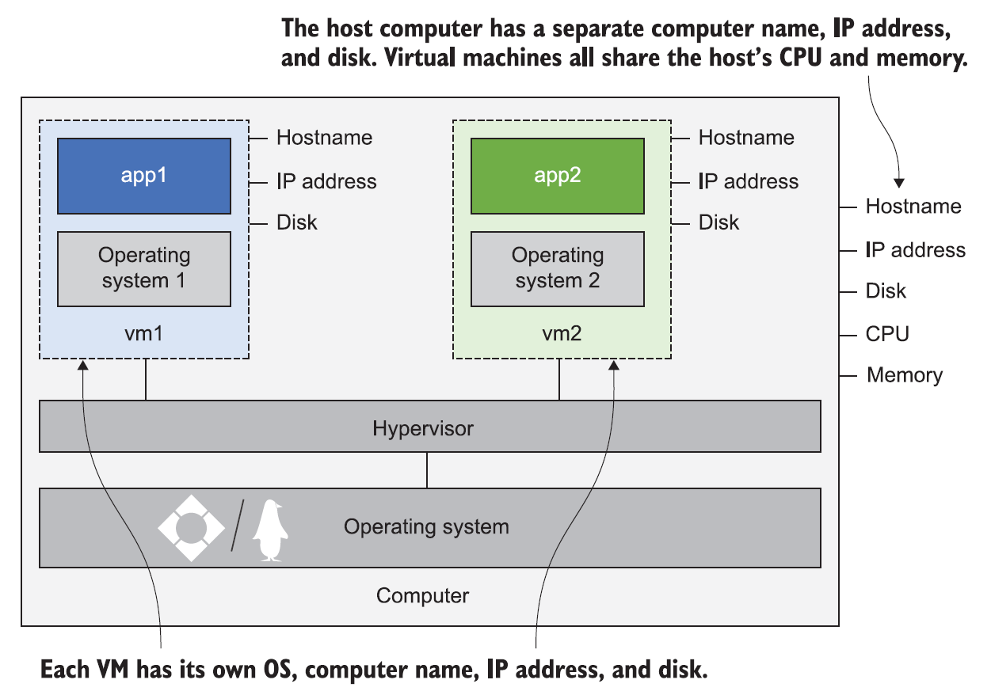
Virtual Machines [1]
Every VM needs its own operating system, and that OS can use gigabytes of memory and lots of CPU time—soaking up compute power that should be available for your applications.
There are other concerns too, like licensing costs for the OS and the maintenance burden of installing OS updates.

Slide 6
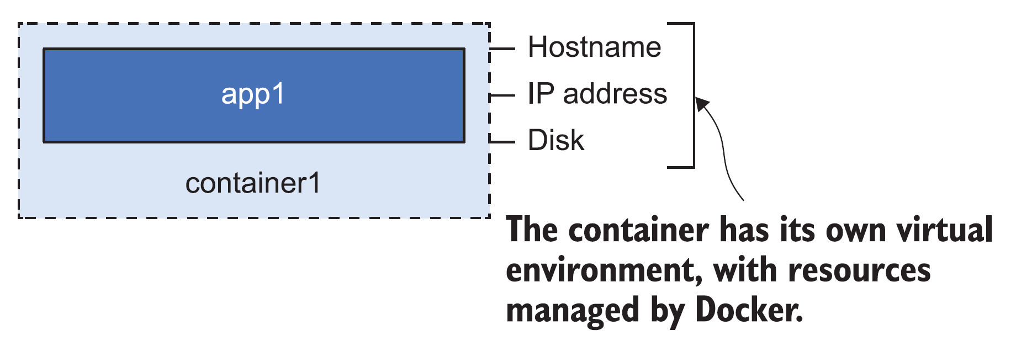
What is a Container?
A Docker container is the same idea as a physical container—think of it like a box with an application in it.
Inside the box, the application seems to have a computer all to itself: it has its own machine name and IP address, and it also has its own disk drive.

Slide 7
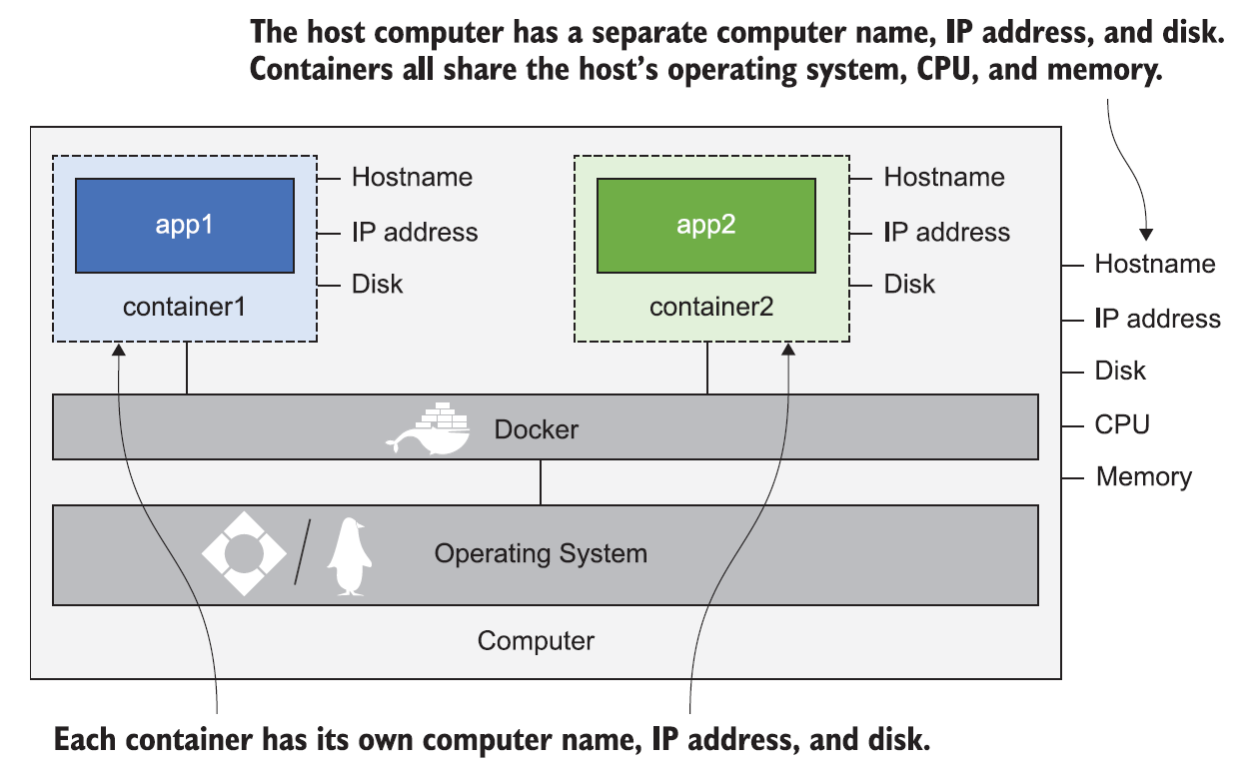
Multiple Containers
The application inside the box can't see anything outside the box, but the box is running on a computer, and that computer can also be running lots of other boxes.
They all share the CPU and memory of the computer, and they all share the computer's operating system.

Slide 8


Slide 9
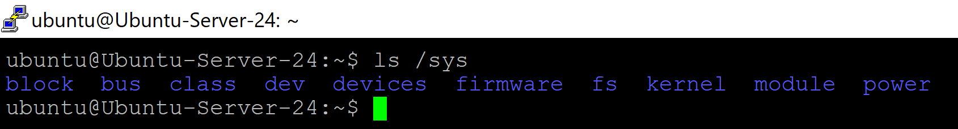
The /sys directory [2]
A virtual filesystem containing device drivers, device information, and other kernel features.
ls /sys

Slide 10
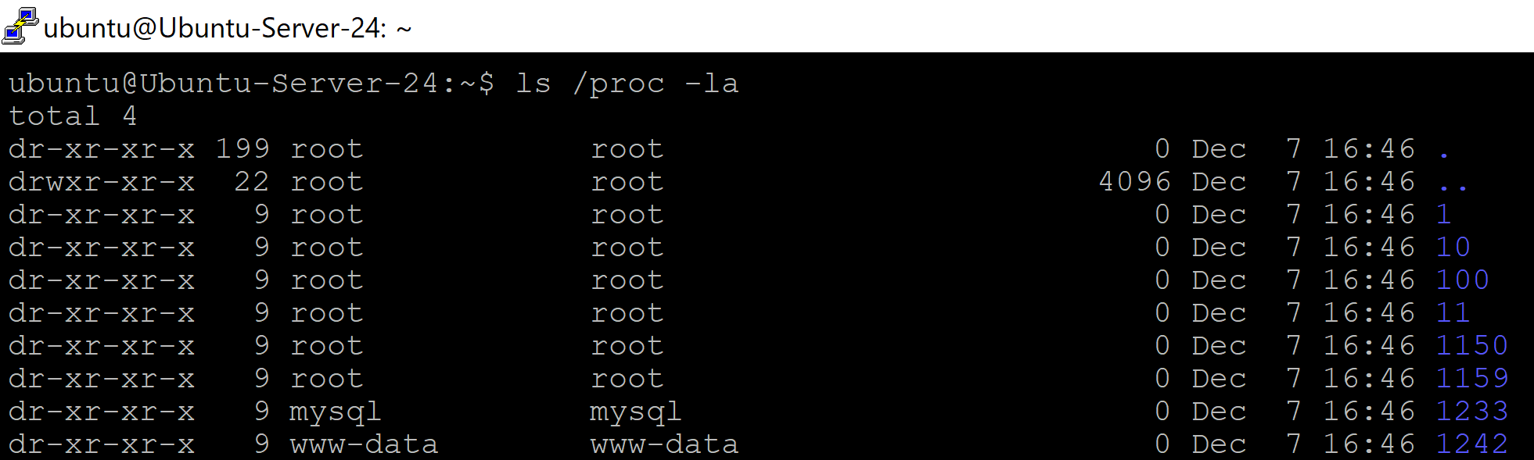
The /proc directory
The /proc directory is also known as procfs, and it contains useful information about processes that are currently running.
ls /proc -la

Slide 11
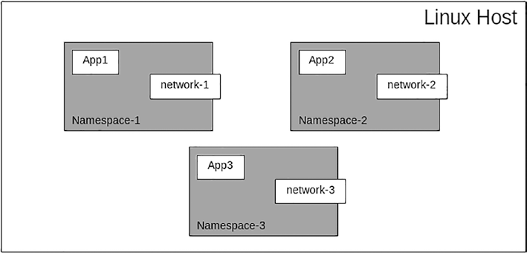
Linux Namespace
A namespace is a feature provided by the Linux kernel for creating an isolated environment for processes that you want to run with their own resources.
Each application that is running inside a namespace cannot access anything outside its own namespace.
For example, App1 cannot access App2 resources.

Slide 12
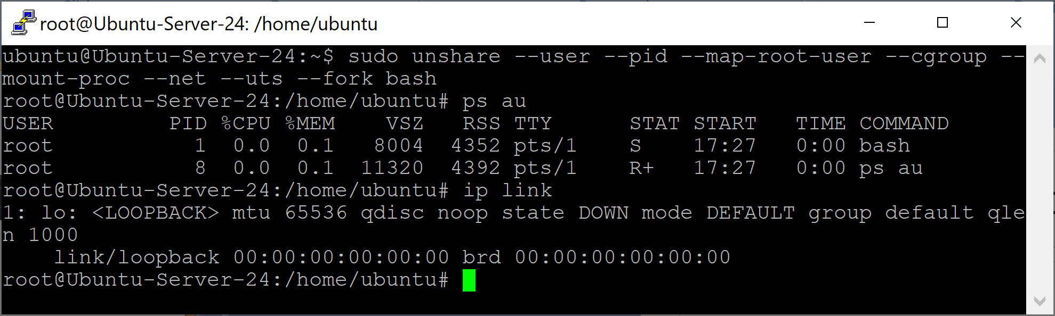
1. Create a namespace
# list processes: ps au
# list network interfaces: # ip link
# create a namespace and run bash inside the created namespace:
sudo unshare --user --pid --map-root-user --cgroup --mount-proc --net --uts --fork bash

Slide 13
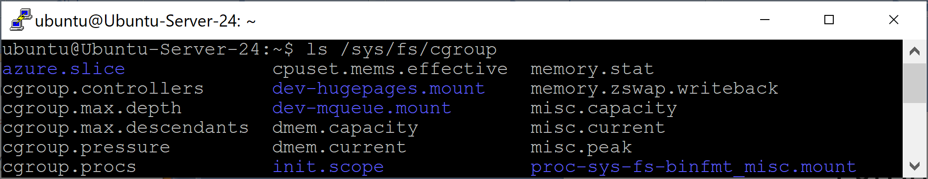
cgroups
cgroups stands for control groups, which is a feature provided by the Linux kernel.
Namespaces go hand in hand with cgroups.
cgroups gives users the ability to limit certain resources such as the CPU and memory network allocated for a particular process or processes.
cgroups resides inside the /sys/fs/cgroup directory.
ls /sys/fs/cgroup

Slide 14
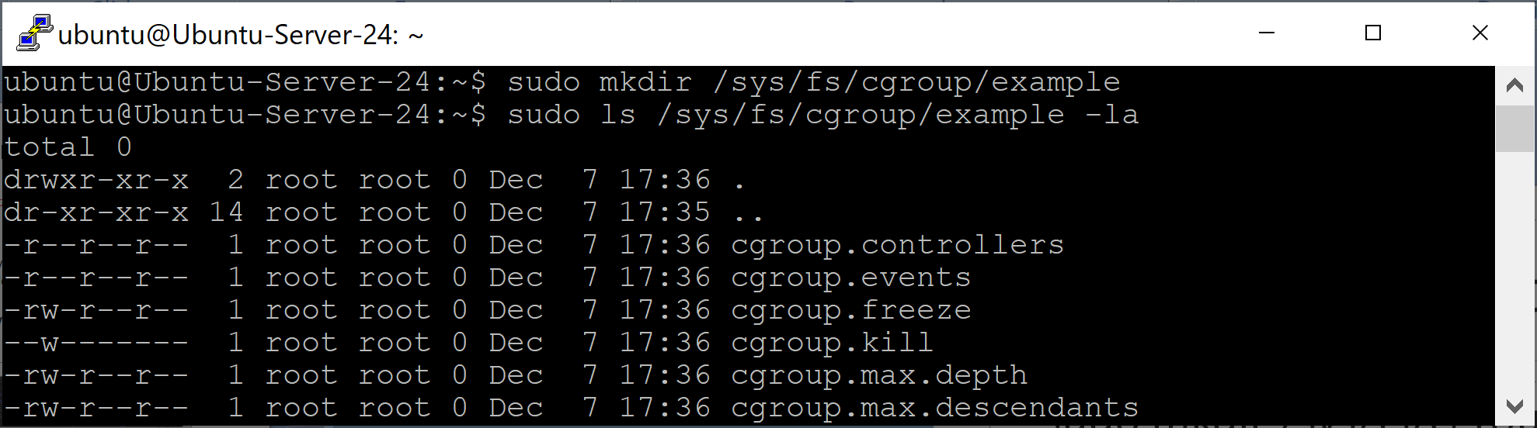
2. Create a cgroup
sudo mkdir /sys/fs/cgroup/example
sudo ls /sys/fs/cgroup/example -la

Slide 15
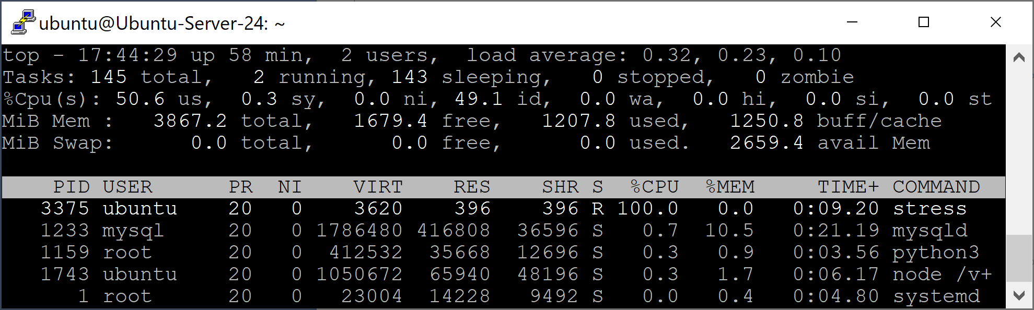
3. Create a new process
sudo apt install stress
# The application will run for 60 seconds using one core and consuming 100% of CPU usage:
stress --cpu 1 --timeout 60
# Open another terminal:
top

Slide 16
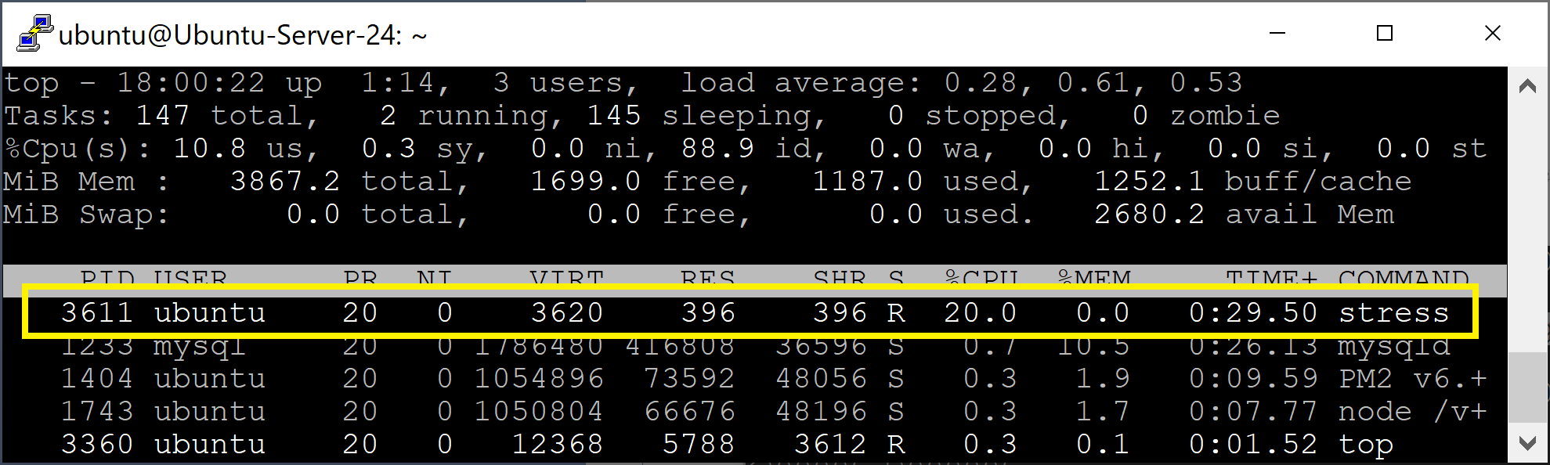
4. Add a process to a cgroup
# tee is a standard Unix utility that reads from standard input and writes the data to both standard output and one or more files.
# quota = 200000 microseconds
# period = 1000000 microseconds (1 second)
echo "200000 1000000" | sudo tee /sys/fs/cgroup/example/cpu.max
# Insert the value of the process id into the cgroups directory:
echo "3611" | sudo tee /sys/fs/cgroup/example/cgroup.procs

Slide 17
rootfs
rootfs stands for root filesystem, which simply means it is the filesystem containing all the basic necessary files required to boot the operating system.
Without the correct rootfs, the operating system will not boot up and no application can run.
rootfs is required so that the operating system can allow other file systems to be mounted, which includes configuration, essential startup processes and data, and other filesystems that are located in other disk partitions.

Slide 18
Minimal rootfs
https://www.alpinelinux.org/downloads/
Alpine is a very well-known Linux distribution that is used widely when creating containers because of its small image size.
# Check machine architecture:
uname -m
wget https://dl-cdn.alpinelinux.org/alpine/v3.23/releases/x86_64/alpine-minirootfs-3.23.0-x86_64.tar.gz
mkdir alpine-rootfs
tar -xvf alpine-minirootfs-3.23.0-x86_64.tar.gz -C alpine-rootfs
ls alpine-rootfs

Slide 19
chroot
chroot in Ubuntu (and all Unix-like systems) is a mechanism that changes the apparent root directory (/) for a running process.
After entering a chroot, the process cannot "see" files outside that directory subtree.

Slide 20
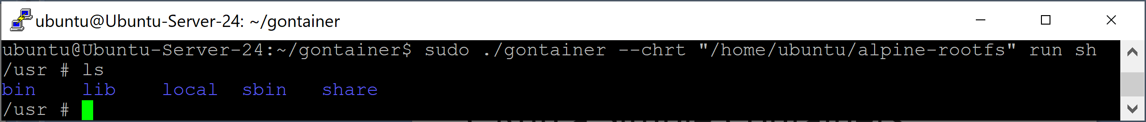
5. Run a Simple Container
git clone https://github.com/nanikjava/gontainer.git
cd gontainer
go build
ls
sudo ./gontainer --chrt "/home/ubuntu/alpine-rootfs" run sh
ls

Slide 21
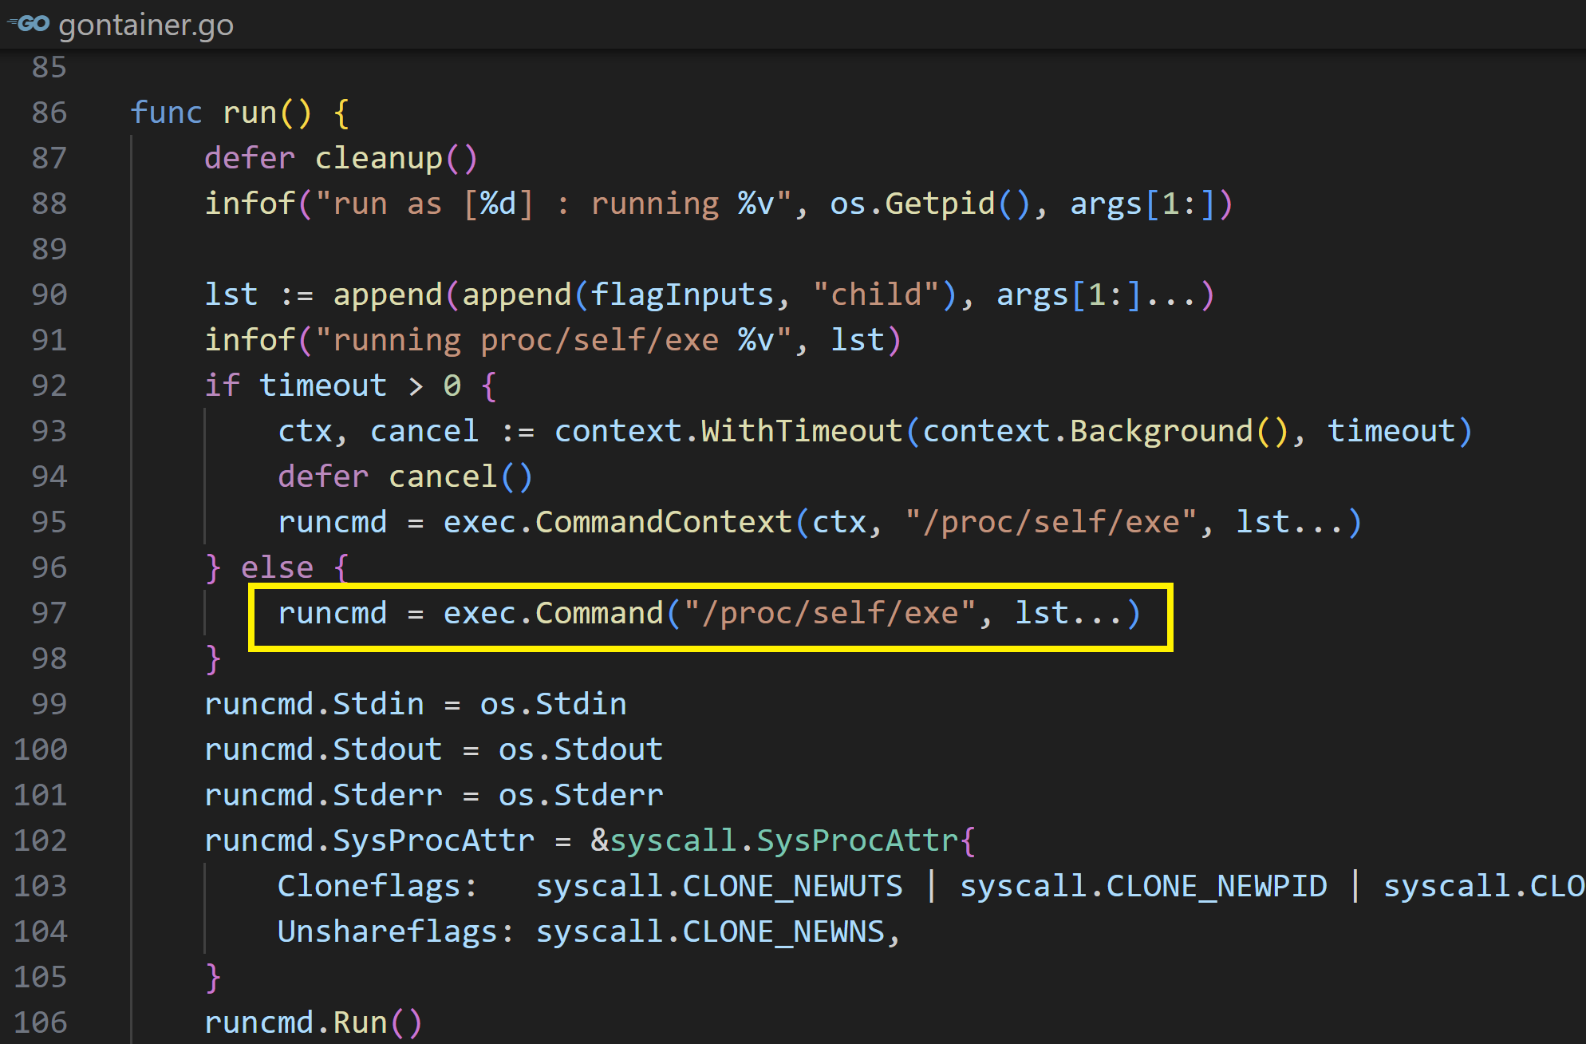
6. Create a Process

Slide 22
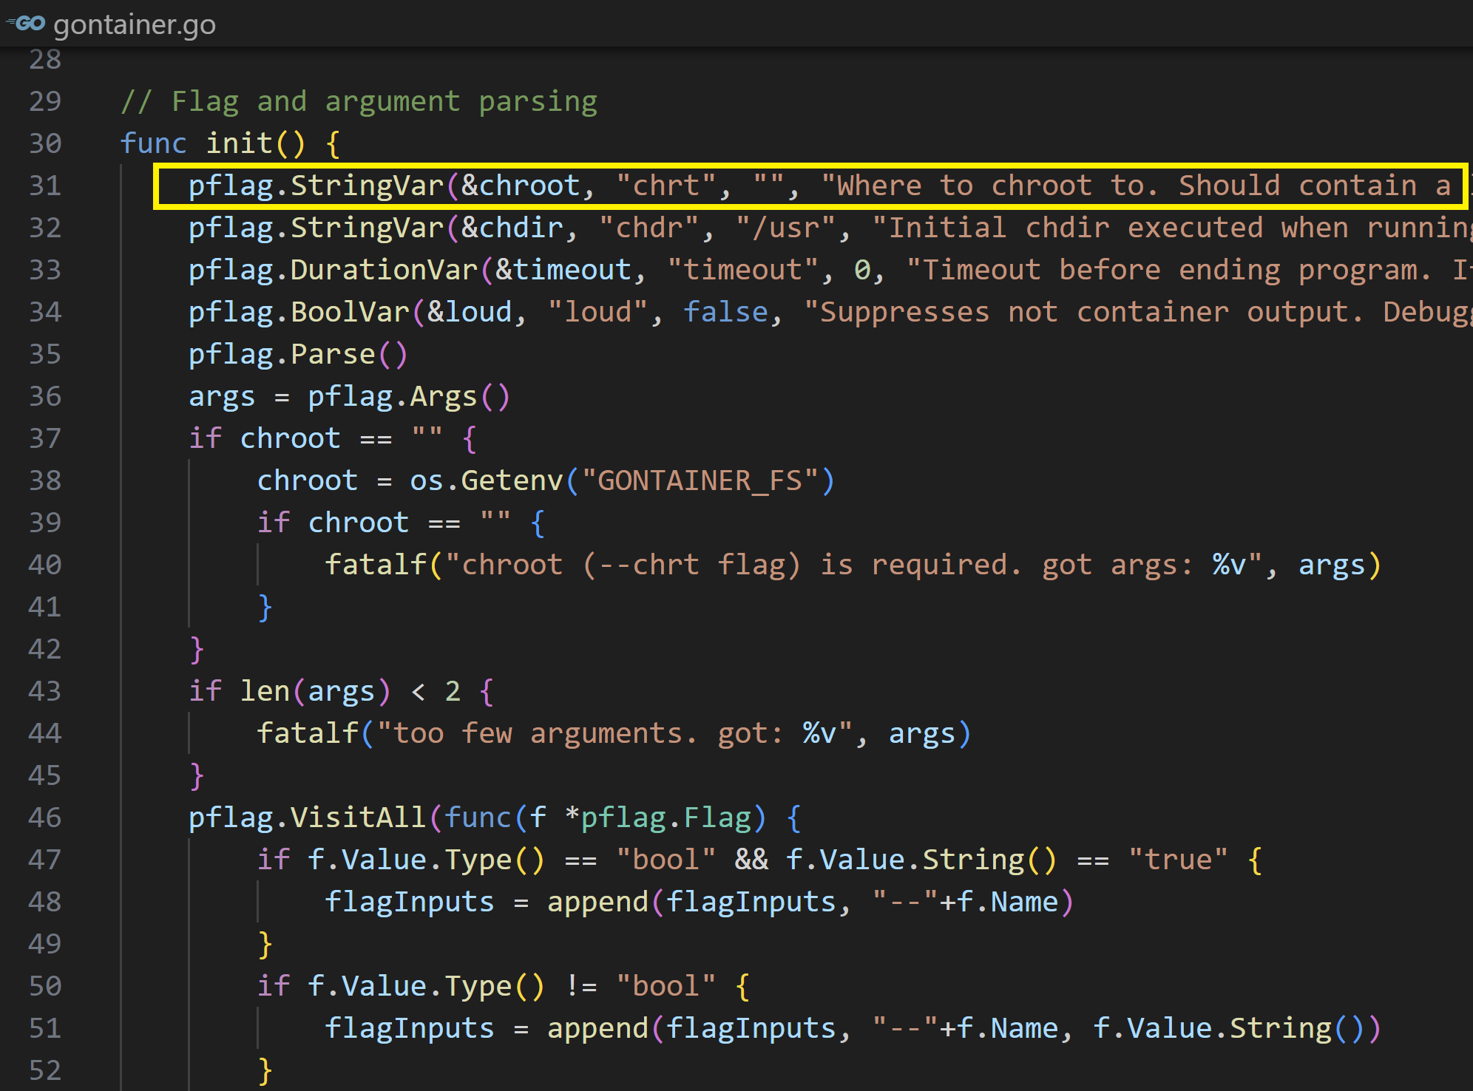
7. Set chroot

Slide 23

Further Reading
Liz Rice (2020). Container Security - Fundamental Technology Concepts that Protect Containerized Applications. O'Reilly Media.

Slide 24

Thank You & See You Again

